Slide 1
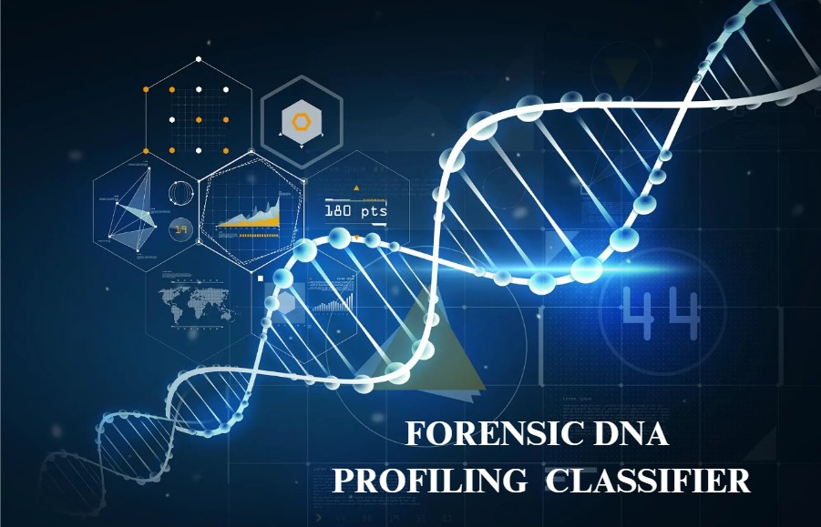

Slide 2

DAYANANDA SAGAR UNIVERSITY
FORENSIC DNA PROFILING CLASSIFIER
UNDER THE GUIDANCE OF:
Dr . KAKOLI BORA
Associate professor
Dept CSE-DS
DSU
CHAITHRA.K[ENG21DS0014]
SHUBHAM KUMAR [ENG21DS0039]
NIVAS REDDY[ENG21DS0046]

Slide 3
OVERVIEW
Abstract
Introduction
Literature survey
Problem statement
Societal impact
Dataset
Design and Proposed Methodology
Innovation /research component

Slide 4
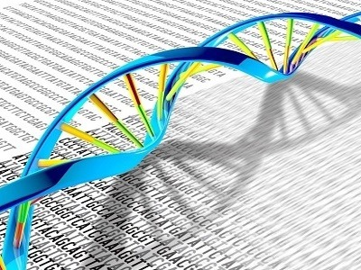
ABSTRACT
Natural disasters cause immense loss of human life and widespread grief as loved ones are lost.
In the face of devastation, connecting the deceased with their families is a humane endeavor. Utilizing DNA analysis and machine learning techniques is crucial for achieving this connection.
Deep learning advances automate feature extraction, enhancing the classification of DNA sequences and offering valuable insights for automating DNA analysis.
This project utilizes advanced DNA analysis and machine learning where it performs DNA sequencing ,classification and gene matching to reunite disaster victims with their families, offering hope and easing suffering.

Slide 5
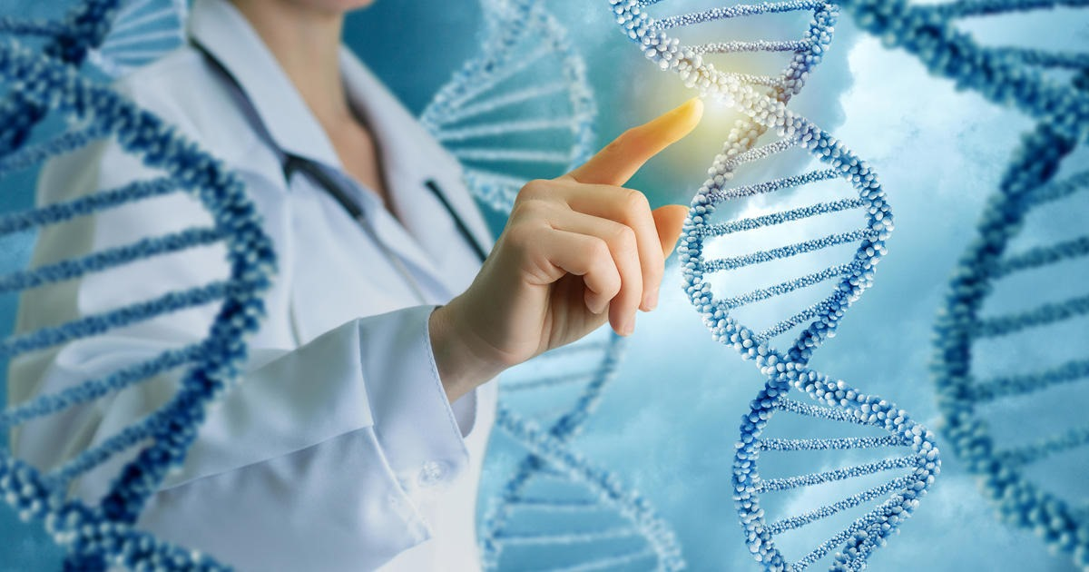
INTRODUCTION
Natural disasters bring inevitable loss of life, causing widespread grief as individuals lose loved ones. These events are a painful reality in our world.
Amidst the overwhelming devastation, the only solace we can offer is the opportunity to connect the deceased with their grieving loved ones. To address this humanitarian need, harnessing the power of DNA analysis and machine learning techniques to bridge the gap between the deceased and their families is necessary .

Slide 6

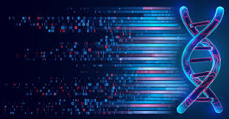
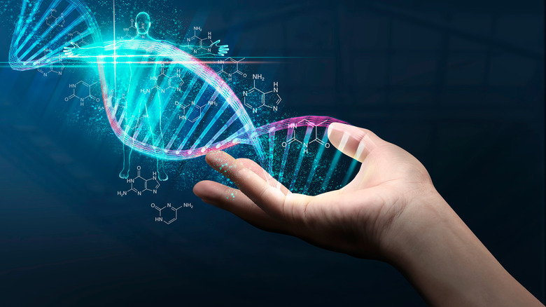
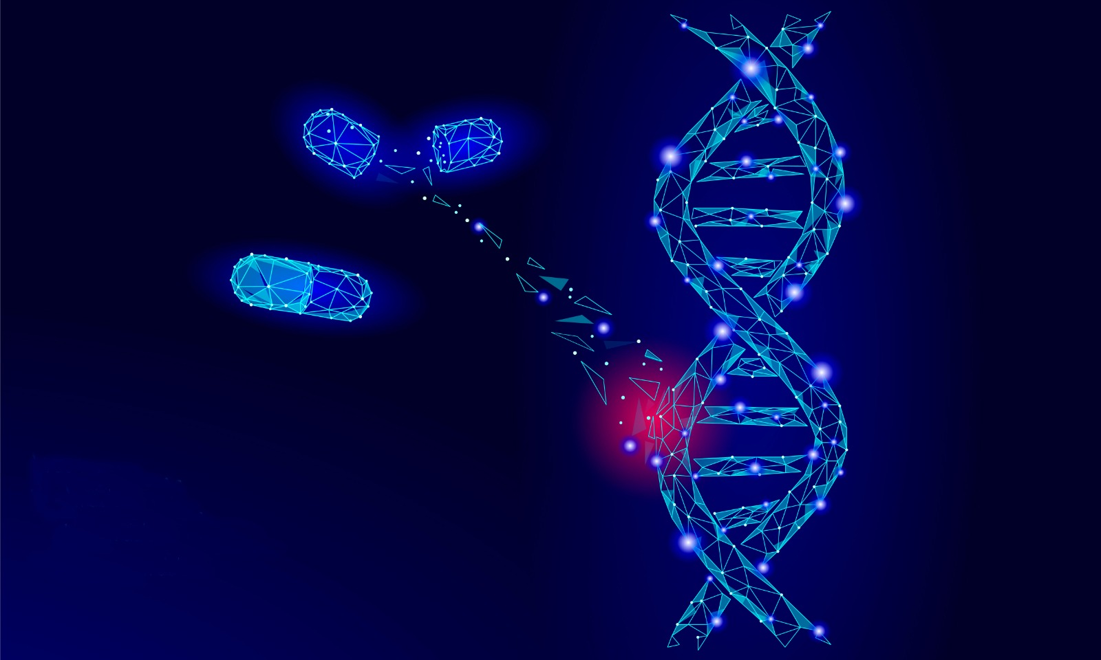
This project collects DNA samples from disaster victims, using advanced analysis and machine learning for classification. Our aim is to reunite them with their families, providing hope and closure during these tragic events, and easing the suffering in our communities.
Recent advancements in deep learning automates feature extraction from input data. this research introduces deep learning frameworks to classify DNA sequences, overcoming feature extraction challenges. These models are evaluated using a diverse DNA sequence dataset, providing insights into automating DNA analysis.

Slide 7
LITERATURE SURVEY
SL.NO | AUTHOR’S NAME | ARTICLE /PUBLICATION | METHODOLOGY | LIMITATIONS
1. | Varada Venkata Sai Dileep, Navuduru Rishitha, Rakesh Gummadi, Natarajan.P | International Journal of Innovative Technology and Exploring Engineering (IJITEE) ISSN: 2278-3075 (Online), Volume-11 Issue-10, September 2022 | DNA Sequencing using Machine Learning and Deep Learning Algorithms | A significant challenge is time-consuming data processing due to the large DNA dataset size. Extracting, transforming, and learning (ETL) processes are essential,
2. | Hemalatha Gunasekaran,¹K. Ramalakshmi,²A. Rex Macedo Arokiaraj,¹S. DeepaKanmani,³Chandran Venkatesan,⁴andC. SureshGnanaDhas | Research Article | Open AccessVolume 2021 | Article ID 1835056 | Analysis of DNA Sequence Classification Using CNN and Hybrid Models | Algorithm Development and Optimization: Designing efficient and accurate algorithms for DNA sequencing and genome matching specific to natural disaster datasets is a challenge.

Slide 8
Uing iot to nitfuy
3. | Sapna Juneja, Annu Dhankhar, Abhinav Juneja, Shivani Bali | International Journal of Reliable and Quality E-Healthcare (IJRQEH) 11(2) | An Approach to DNA Sequence Classification Through Machine Learning: DNA Sequencing, K Mer Counting, Thresholding, Sequence Analysis | Computational Resources:Genomic data analysis demands high-performance computing, posing challenges for organizations with limited computational resources and complex genome matching algorithms.
4. | J. A. M. Rexie , 1 Kumudha Raimond,1 Mythily Murugaaboopathy,1 D. Brindha,1 and Henock Mulugeta | Hindawi Computational Intelligence and Neuroscience Volume 2022, Article ID 6980335, 16 pages | Lightweight Pattern Matching Method for DNA Sequencing in Internet of Medical Things | Integrating diverse disaster DNA data is complex due to varied sources and formats. Ensuring data consistency and harmonization while maintaining integrity presents technical challenges.

Slide 9
5. | Osman Ali Sadek Ibrahim1 · Belal A. Hamed1 · Tarek Abd El‑Hafeez1,2 | The Journal of Supercomputing (2023) 79:367–388 | A new fast technique for pattern matching in biological sequences | Scalability: Anticipating and accommodating scalability requirements to handle an increase in data volume, especially during a widespread disaster, is a technical limitation.

Slide 10
PROBLEM STATEMENT
In context of natural disasters, situations arise where conventional DNA profiling methods fail to provide matches. Additionally, when working with limited or degraded DNA samples, the task becomes even more daunting. Addressing this challenge necessitates the seamless integration of advanced forensic genetic techniques.
In cases with no DNA profile match, low sample quantity, or degraded DNA, Effectively integrating innovative forensic genetic methods into practice is a critical challenge, ensuring their optimal utility and benefits are realized in forensic investigations . The challenge lies in effectively integrating these innovations into forensic practice to maximize their benefits and utility, Traditional [STR]short tandem repeats profiling may not suffice for challenging samples with low or degraded DNA.
Hence we are Creating a comprehensive forensic DNA analysis software solution to efficiently identify suspects, victims, and missing persons, improving the DNA profiling accuracy, and manage evidence securely.

Slide 11
SOCIETAL IMPACT
This software project utilizing DNA sequencing and genome matching from natural disaster datasets has profound societal implications.
Forensic Genomics in Disasters: Forensic genomics plays a crucial role in disaster scenarios, helping identify victims and support mass casualty response.
Victim Identification after Disasters: DNA analysis in disasters (e.g., tsunamis, earthquakes) assists in victim identification, providing closure to families and enabling dignified burials.
Genomic Help in Missing Persons Cases: Forensic genomics aids missing persons investigations, creating genetic profiles for comparisons, crucial for damaged or decomposed bodies.
Genomics for Humanitarian Relief: Forensic genomics reunites families in refugee crises and conflicts, demonstrating its value in humanitarian efforts.

Slide 12
DATASET
Dataset description : The dataset contains human DNA sequences labeled with corresponding classes, representing specific classifications . These sequences have been systematically collected and organized for the purpose of classification and analysis, facilitating research and insights into genetic pattern matching and attributes.
Dataset used : https://raw.githubusercontent.com/krishnaik06/DNA-Sequencing-Classifier/master/human_data.txt

Slide 13
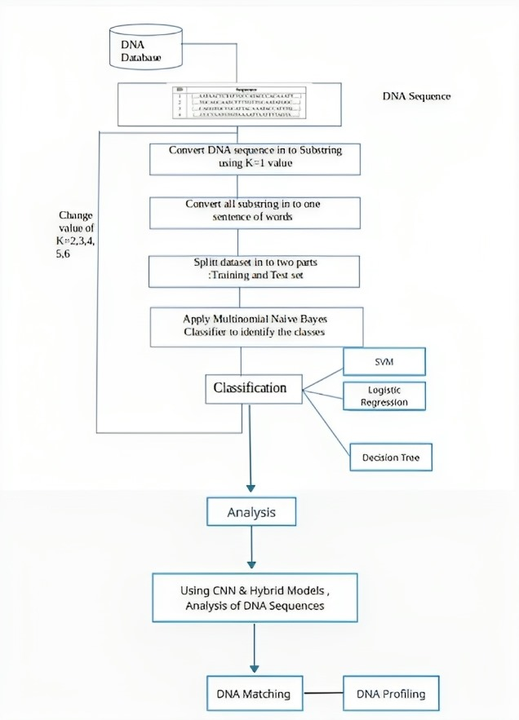
DESIGN

Slide 14
PROPOSED METHODOLOGY
We propose the idea in which the testing of DNA is accomplished by comparing STR regions of known STR DNA profiles with unknown STR DNA profiles, such as profiles that have been taken from a natural calamity or disaster scene. These profiles usually consist of incomplete STR profiles from an number of unknown contributors
Our dataset comprises of profiles that might be encountered in actual cases. Numerous machine learning and deep learning interpretation tools, as well as analysis techniques, have been created to address DNA mixtures. Initially, DNA sequencing is performed. Subsequently, the dataset undergoes classification using a classifier. Following classification, gene matching is conducted, culminating in the completion of the DNA analysis process.
It is essential to know the features related to our dataset , hence we applied two techniques: the correlation matrix and univariate selection .we use confusion matrix for training and testing datasets . we incorporate [CNN]convolution neural network, [SVM]support vector machine and other machine learning techniques to classify and do the analysis of the dataset and find the matching percentage of the unknown DNA among the existing known DNA dataset.
Hereby , making the task of finding a persons DNA match easier . Hence saves a lot of time and trouble.

Slide 15
INNOVATION/RESEARCH COMPONENT
This project focuses on DNA sequencing, classification, and thorough analysis. Furthermore, we are actively integrating a gene matching component to enhance the accuracy and efficiency of our analysis processes.
Gene matching :Gene matching is a new method for performing multivariate matching which uses our research it introduces deep learning frameworks to classify DNA sequences, overcoming feature extraction challenge Utilizing machine learning algorithms to interpret complex DNA profiles, identify patterns, and improve the accuracy of matches, especially when dealing with mixtures or partial profiles. The model is evaluated using a diverse DNA sequence dataset.
Natural disasters result in inevitable loss and widespread grief as loved ones are lost , hence we perform gene matching to match the DNA of the deceased people during these calamities to the existing records of people ,thereby Our aim is to reunite them with their families, providing hope and closure during these tragic events, and easing the suffering in our communities.

Slide 16
THANK YOU

